Slide 1


Missing Substance Detection
TIFR Project
Project Mentors:
Mrs. Priya R L
Dr. Sharmila Sengupta
Group Members:
56 - Tanay Phatak
67 - Tanmay Thakare
71 - Gautam Wadhwani
09 - Sakshi Bhojwani
Group Number : 29
Date: 26/01/2024

Slide 2
Content
Project Objective
Modular Diagram
Progress
OCR and Deskewing
Car Color Recognition
Car Model Identification
Future Work Plan
Re-Identification

Slide 3
Project Objective
Substance: Cars
Data Source: CCTV footage
Recent Focus: Model and Color of Cars, and Number Plate Recognition
Notes:
Tanmay

Slide 4
Assignment
To work on color identification of car
To find out some text based Image Resolution technique
Notes:
Tanmay

Slide 5
Progress
Progress so far:
Converting frames from videos and Object(Car) detection.
Car number plate cropping.
Deskewing of number plate image for better OCR.
Number Plate Recognition using EasyOCR.
Car color recognition.
Car model identification.
Notes:
Mention 2 points: image overlaps and blur image similarity

Slide 6
OCR and Deskew
EasyOCR
EasyOCR is an open-source OCR library with robust language support, enabling seamless extraction of text from images in various scripts.
We tested EasyOCR on unprocessed cropped number plate images and then on deskew images.
Deskew
Performed deskewing using OpenCV functions like HoughLinesP and getRotationMatrix2D to automatically detected the amount of rotation required and perform the required processing.

Slide 7




OCR and Deskew
Deskewing Results (using OpenCV):
Original image
Deskew image
OCR Results on original image
OCR Results on deskew image

Slide 8
Car Model Identification
EfficientNet B1 Model
EfficientNet uses a technique called compound coefficient to scale up models in a simple but effective manner.
Instead of randomly scaling up width, depth or resolution, compound scaling uniformly scales each dimension with a certain fixed set of scaling coefficients.
Dataset: It contains 4000 images of two of the popular cars (Swift and WagonR).
Theory of EfficientNet B1 Model

Slide 9
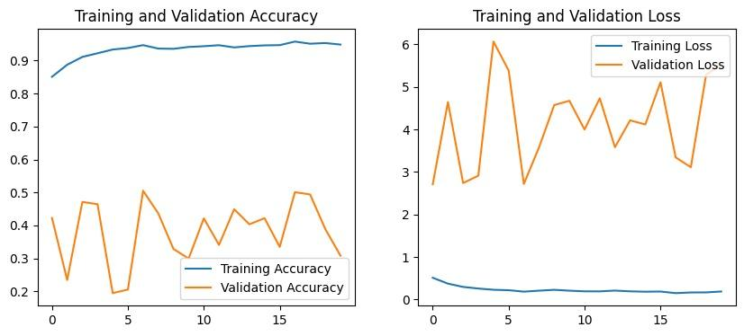
Car Model Identification
Model performance on Dataset-1 of 196 Classes

Slide 10
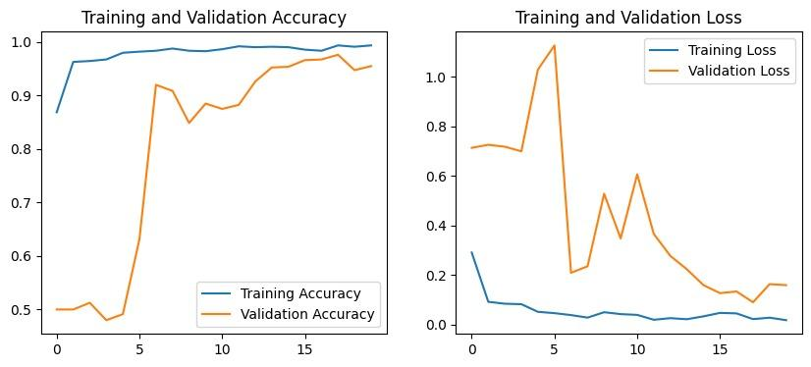
Car Model Identification
Model performance on WagonR-Swift dataset

Slide 11
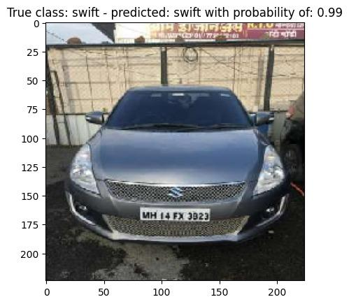
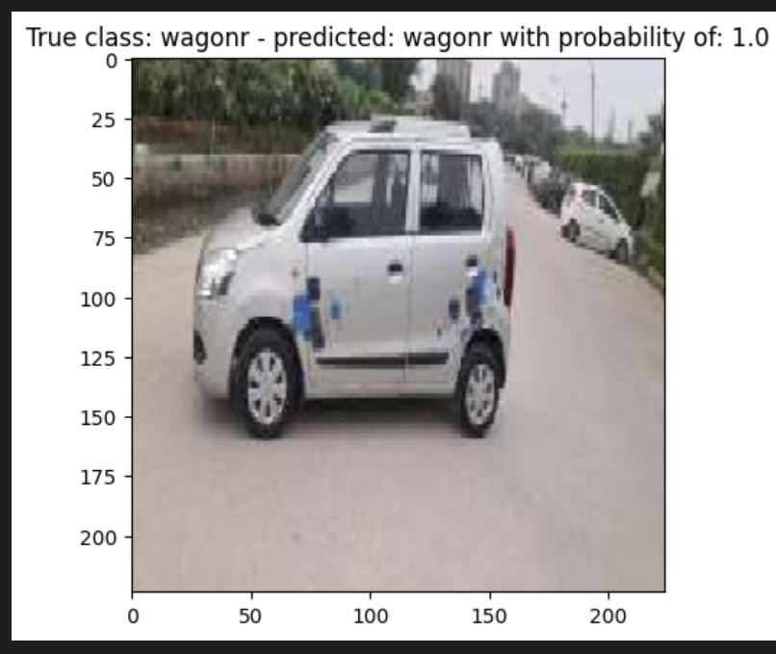
Car Model Identification
Testing Dataset Images

Slide 12
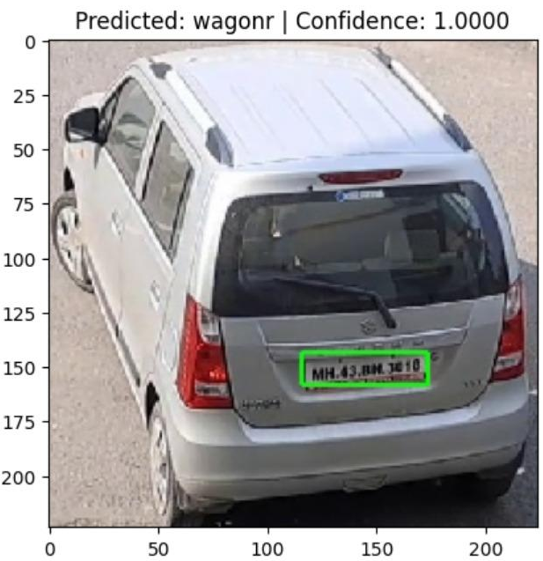
Car Model Identification
Test on video frame

Slide 13
Car Color Recognition
EfficientNet B1 Model
EfficientNet uses a technique called compound coefficient to scale up models in a simple but effective manner.
Instead of randomly scaling up width, depth or resolution, compound scaling uniformly scales each dimension with a certain fixed set of scaling coefficients.
Dataset: It contains 812 black, 1186 blue, 1038 red, 717 white car images for training the model, total of 3753 images.
Theory of EfficientNet B1 Model

Slide 14
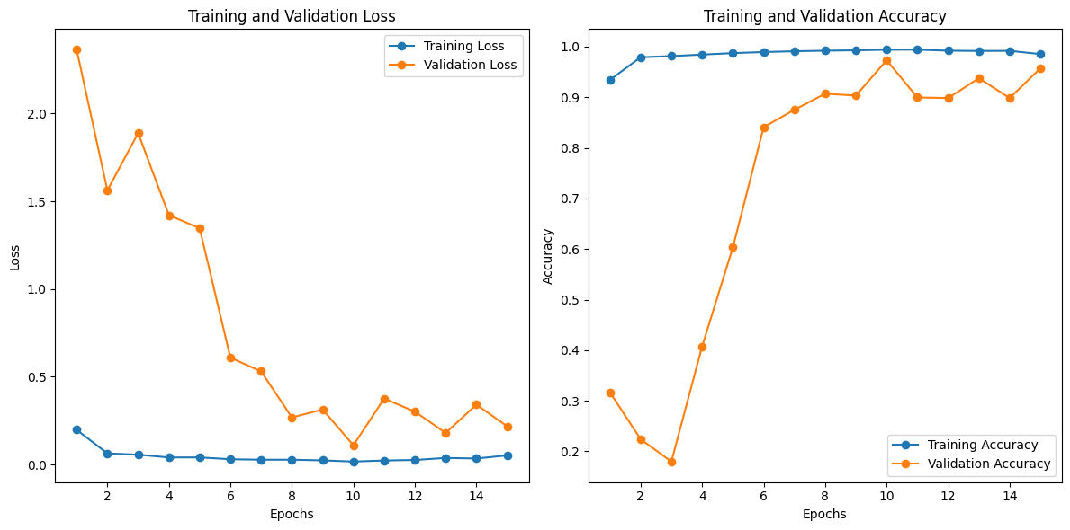
Car Color Recognition

Slide 15
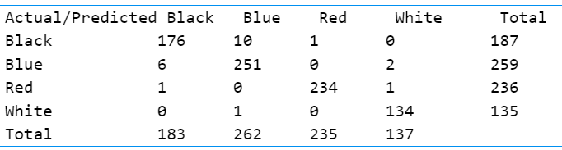
Car Color Recognition
Confusion Matrix

Slide 16
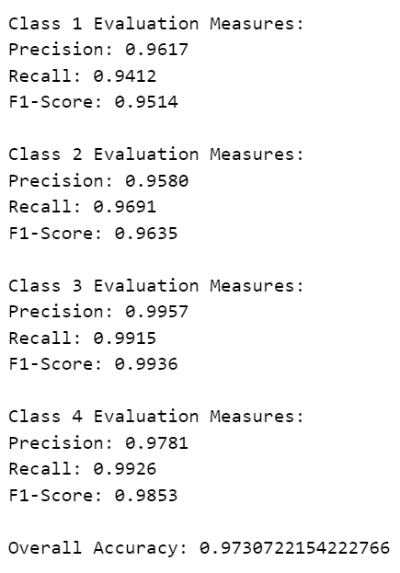
Car Color Recognition

Slide 17
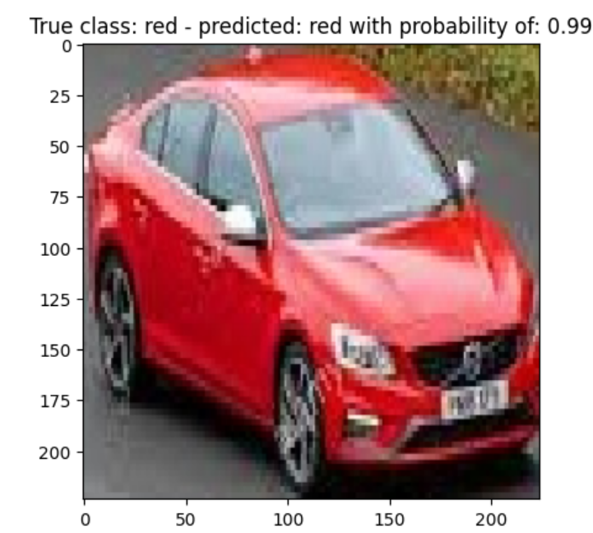
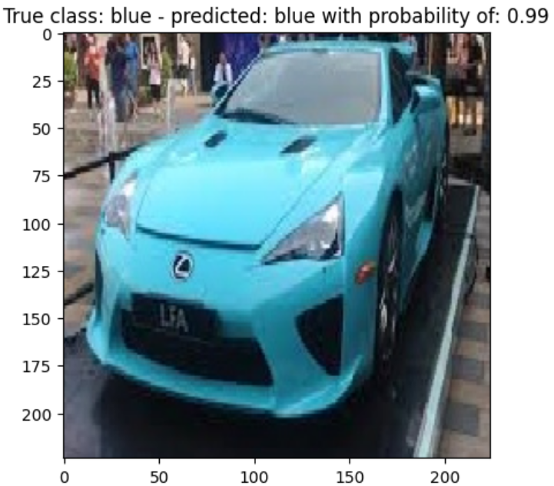
Car Color Recognition
Testing Dataset Images

Slide 18
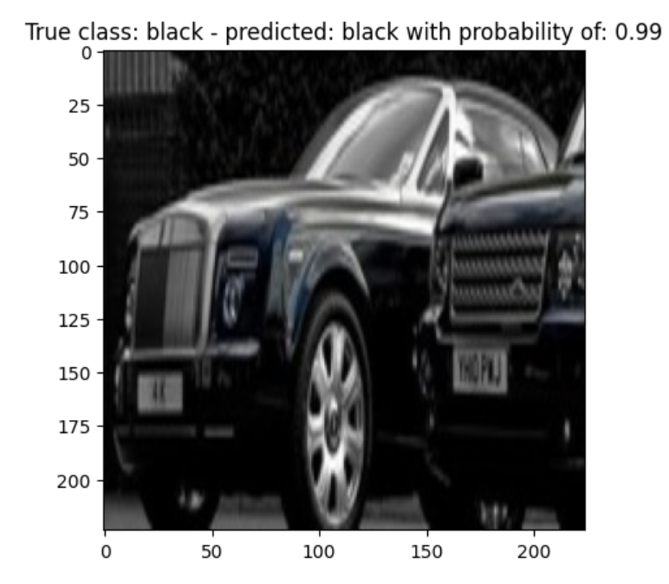
Car Color Recognition
Testing Dataset Images

Slide 19
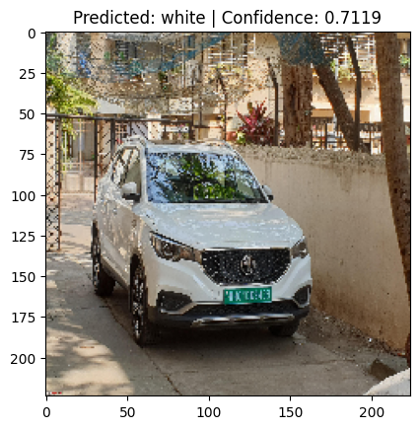
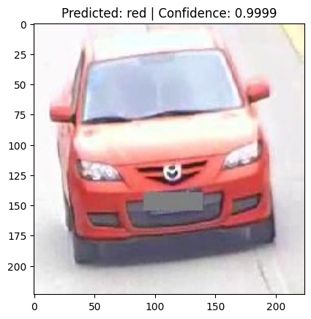
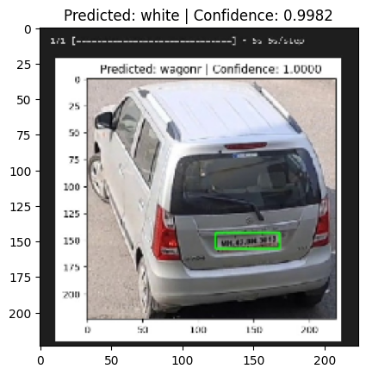
Car Color Recognition
Test on video frame

Slide 20
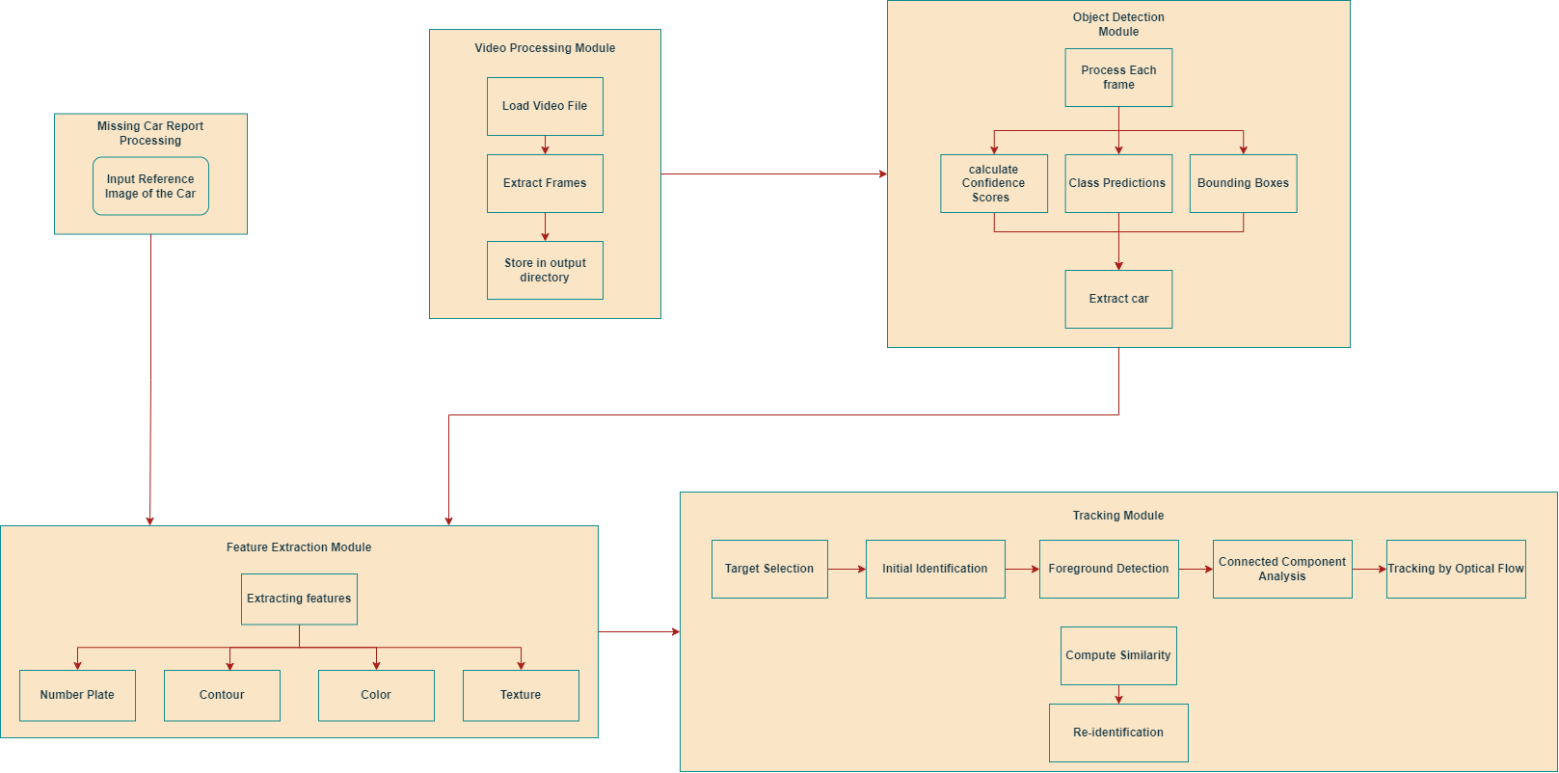
Modular Diagram

Slide 21
Future Work Plan
Next we plan to do the following:
Perform car tracking using algorithms like SORT and DeepSORT.
Perform car re-identification using deep learning models like Siamese Networks trained on reid datasets like VeRi, etc.
Create an interactive interface using Pyqt and sqlite.
Further, we try to explain the importance of re-identification to this project.

Slide 22
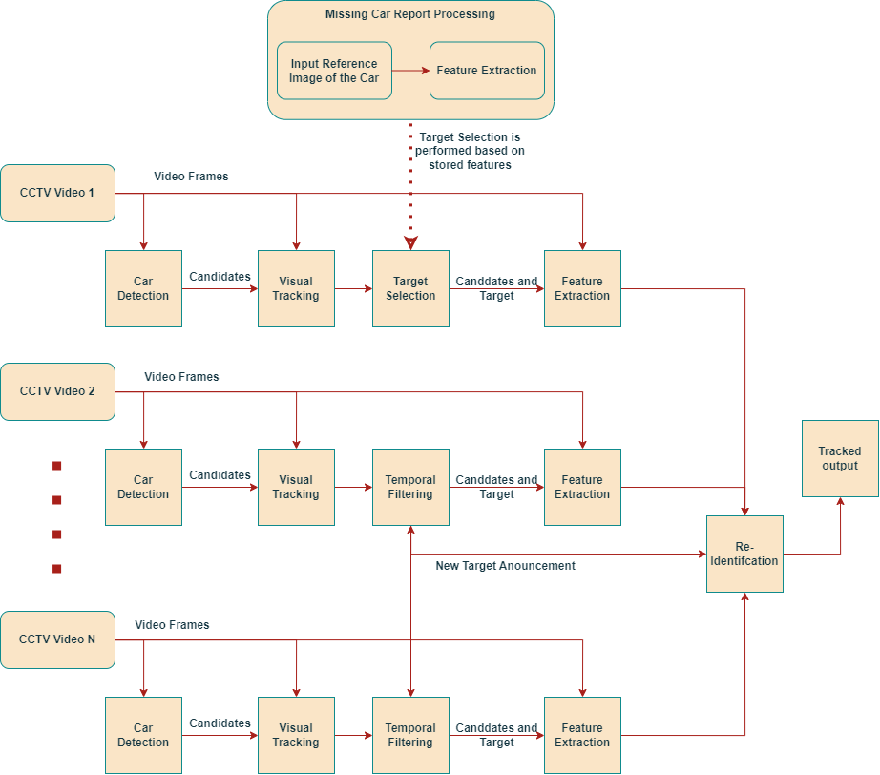
Re-Identification and Tracking

Slide 23
Thank You

